Slide 1
Protecting Student Privacy For Teachers
Brief Overview

Slide 2
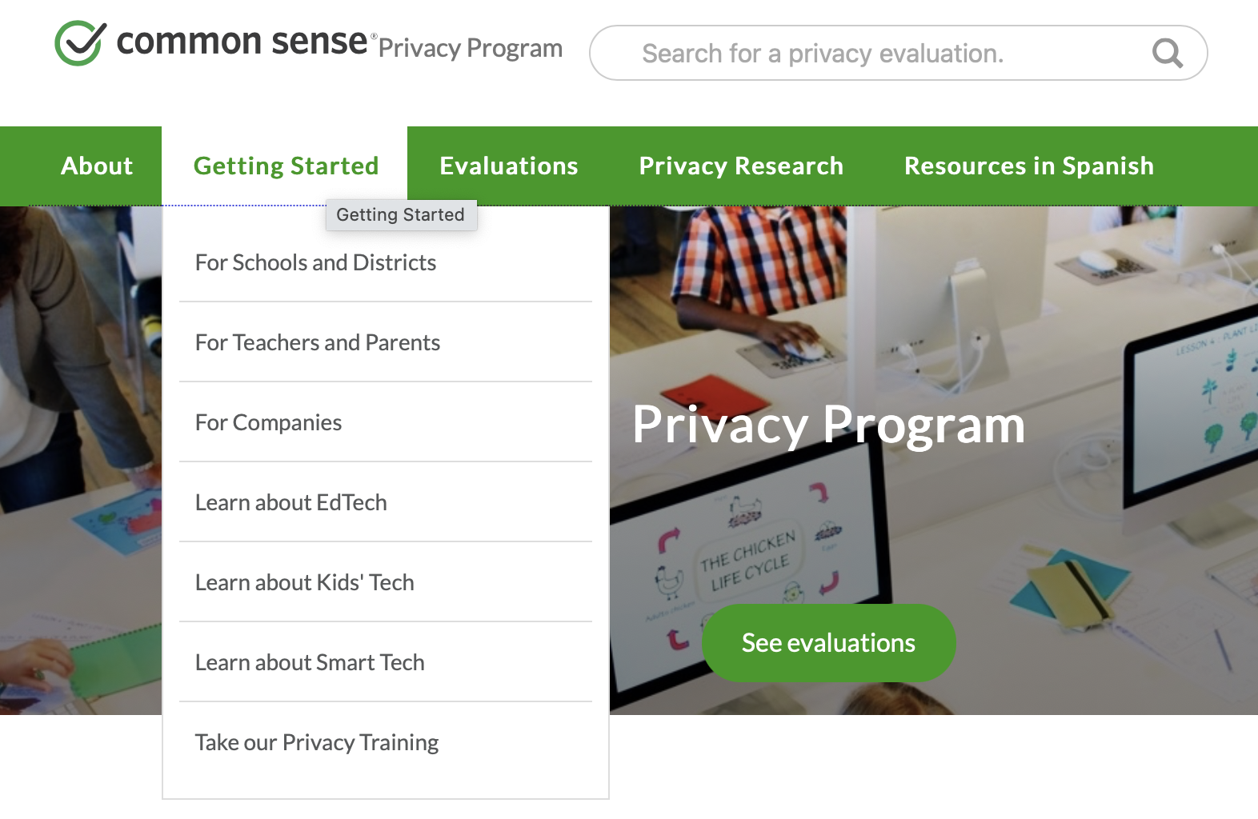

Slide 3
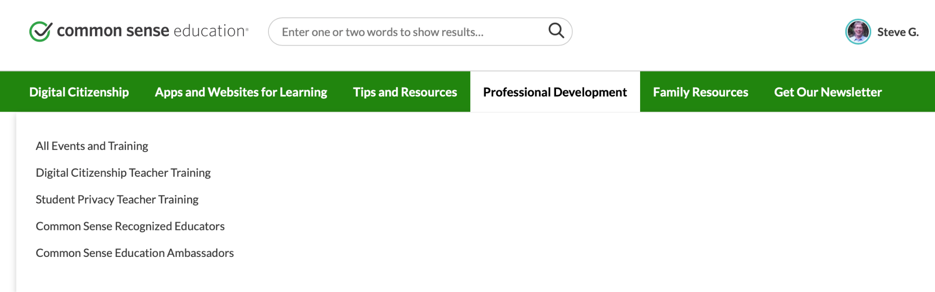

Slide 4
Training Modules
What is Student Privacy?
Student Data
Educational Technology
Vetting Educational Technology
Compliance (FERPA, COPPA, and PPRA)
Communicating with Students and Parents
Teaching Students About Privacy
How to Protect Privacy
New and Emerging Tech
Quiz

Slide 5
What is Student Privacy?

Slide 6
Student data privacy refers to the responsible, ethical, and equitable collection, use, sharing, and protection of student data.
Notes:
Although there are infinite ways to define privacy, for the purposes of this course we are defining student data privacy as the responsible, ethical, and equitable collection, use, sharing, and protection of student data. Student privacy is vital for teachers to think about; any irresponsible data collection, use, and sharing can result in real, long-term consequences for their students. Just like toothpaste squeezed from a tube, it is nearly impossible to get information posted online back after it’s already out there. This course will teach you why and how student privacy must be protected.

Slide 7
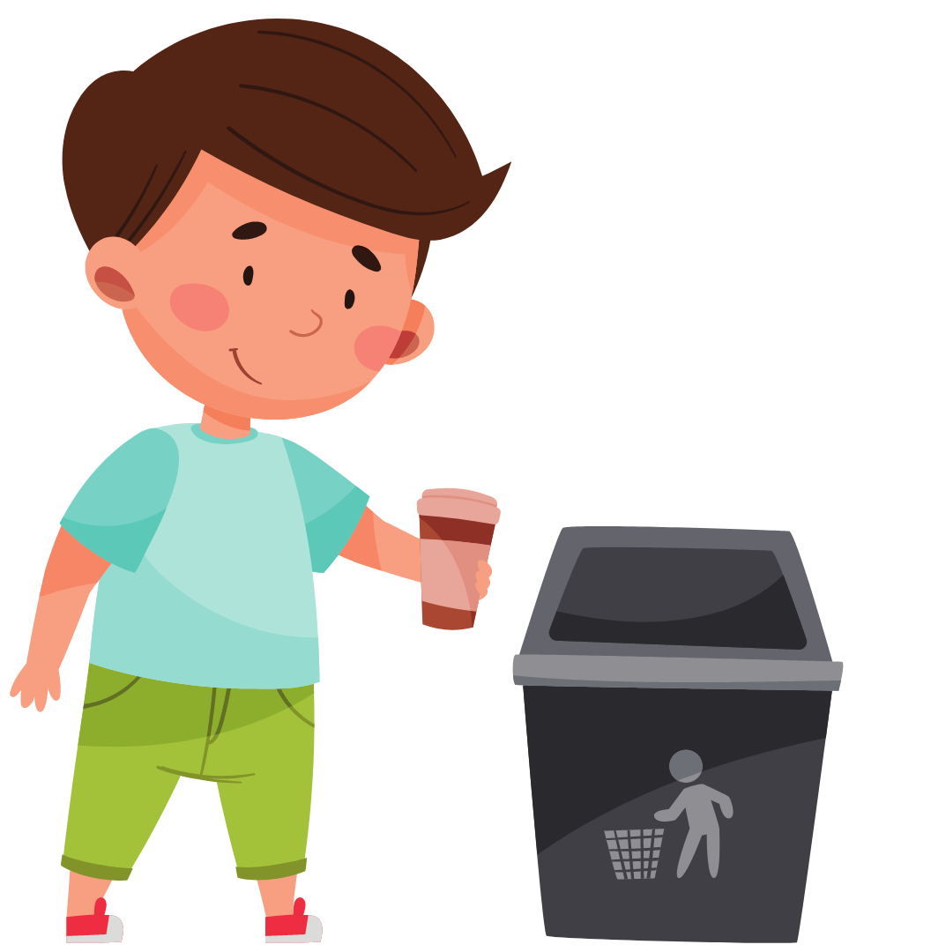
personally identifiable information practices related to….
Collecting
Using
Protecting
Sharing
...and retaining only as long as needed and securely dispose
Notes:
And, just like in the real world, when you are finished using your CUPS, the next step is to responsibly and securely dispose of the student data. Data that doesn’t exist can’t be accidentally shared or used to harm students, so only keep student data as long as you need it. (But be aware that your district may be required to keep certain student data by law - chat with your boss to learn what you can and cannot do!)

Slide 8
Student Data

Slide 9
Risks of Student Data Collection, Use, and Sharing
Risk | Think about…
Safety | Can a stranger or other dangerous person communicate with your students and learn personal information about them?
Permanent Record | Will youthful mistakes that students make follow them forever?
Social Harm | Can collecting and sharing student data contribute to cyberbullying and stigmatization?
Equity Concerns | How might data be biased or used in inequitable ways?
Loss of Opportunity | Will your student lose access to educational opportunities and services?
Commercial | Will companies use student data for profit?
Notes:
Despite the numerous benefits of collecting and analyzing large quantities student data, there remains significant privacy concerns that teachers must consider before jumping to simply maximizing data collection. Can a stranger access this data? Is the data biased in any way? Without appropriate safeguards in place, collecting, using, and sharing student data can create risks to students.

Slide 10
Educational Technology

Slide 11
Benefits of Educational Technology
Personalized Learning
Measuring Success
Technology Literacy
Keeps Learning Interesting & Fun
Notes:
Benefits include the ability to:
Personalized Learning - Educational technologies have the ability to personalize content delivery for individual students. This allows students to receive a customized learning experience tailored to their individual interests and needs.
Measuring Success - Educational technologies can track student progress over time. This enables teachers to visualize their class’s comprehension levels and identify students in need of additional attention.
Technology Literacy - Incorporating educational technologies into your classroom exposes your students to the various technologies and allows them to explore the digital world in a safe, guided environment.
Keeps Learning Interesting & Fun - Educational technology can engage students in new, interactive ways that are designed to keep students interested.

Slide 12
Risks of Using Educational Technology
Risk | Think about…
Safety | Are students able to share personal information with others using this technology?
Permanent Record | How long does the technology retain information about your students?
Social Harm | How might educational technology contribute to or enable cyberbullying and stigmatization of your students?
Equity Concerns | What if students do not have access to information or technology?
Loss of Opportunity | Does this technology make decisions about or impact the opportunities and services your students have access to?
Notes:
When adopting new tools, apps, and products think critically about the purpose and value added. Always ask: does this tool help your students? Is there an already approved alternative? Does it empower students in their own learning?
Once you answer those questions, you can start thinking about potential privacy risks. No matter how great a particular educational technology may be, the benefits must be weighed against the potential risks of harms that the technology poses to your students.

Slide 13
Vetting Educational Technology

Slide 14
Vetting Educational Technology
Safe
Secure
Respected
Notes:
There are three core considerations when vetting educational technology; is student data safe, secure, and respected?
Safe = Student interactions are minimal and any communication with other users has some level of oversight or moderation.
Secure = Steps are taken to prevent unauthorized access to student data. This may include password protection, encryption, and transparent, clear data-security practices.
Respected = Student data is not shared for non-educational purposes.

Slide 15
Reviewing Educational Technology Yourself
Tips | Why?
Always Defer to School & District Policy | District and school policies and procedures set the ultimate rules for what teachers are allowed to do.
Evaluate Privacy Risks | Consider how using the educational technology presents risks to your students regarding safety, permanent records, social relationships, equity, and future opportunities. Can these risks be mitigated?
Review Privacy Evaluations | For many forms of educational technology, Common Sense has already evaluated the privacy policy for you and can present the relevant terms quickly, in simplified language.
Free ≠ Safe | The price of educational technology does not reflect student safety considerations. Free apps can contain terms in their privacy policies that can put your students at risk.
Signing a Contract | A teacher may not have authority to sign a contract for educational technology. Instead, the teacher should first talk to their school’s administration about vetting the technology and whether a formal agreement with the district is required.

Slide 16
Compliance

Slide 17
Different Ways Privacy Laws Come Up
Scenario | How We Might See It…
Pictures of Students | A teacher takes pictures of a student doing schoolwork.
Administering Surveys | A teacher hands out a brief survey to check-in on how their students are feeling.
Apps Requiring Student Accounts | A teacher uses educational technology that logs student participation over time.
Student Health Information | A student has a medical emergency in class and it is reported.
Recording Class Sessions | A teacher records their lectures so they can go back and assess student questions at a later time.
Talking About Student Personal Information | Various teachers eat lunch together and talk about recent academic performances of their shared students.
Celebrating Student Success | A teacher passes out assignments in order of highest grades.
Notes:
Common, everyday classroom activities have the potential to implicate privacy laws. [walk through chart]. It is important for teachers to understand what laws apply to them in their classrooms to empower them to comply with the law. This training will cover three federal privacy laws that commonly come up in classroom settings. These are not the only laws that may impact teachers, as a large number of states have adopted state-specific student privacy laws. Ask your district or school’s administration or legal counsel about what student privacy laws your state has adopted and what you need to know to comply with them.

Slide 18
FERPA

Slide 19
The Family Educational Rights and Privacy Act: FERPA
ACCESS: Guarantees parents (and eligible students) access to their child’s educational records; and
PRIVACY: Prevents unauthorized disclosure of educational records without consent or very specific safeguards
But FERPA was passed in 1974, so interpreting the law in light of today’s technologies can be difficult, even for experts!
Notes:
The first federal law to know about is the Family Educational Rights and Privacy Act, commonly known as FERPA. FERPA primarily covers two things related to educational records: access and privacy. Access is embodied through FERPA’s guarantee that parents and eligible students, defined as students who have turned 18 years old or entered higher education, have the right to access their educational records. FERPA also incorporates privacy protections to prevent the unauthorized disclosure of educational records without consent or specific safeguards.

Slide 20
FERPA Overview
Which information is protected | “Personally identifiable information” in “education records” includes any information linked to a particular student (such as a student’s race and birth date) on paper or online.
When information can be shared: Consent | When parents give consent - usually in writing - a student’s data can be shared. This can’t be a blanket consent - you can’t ask parents to consent to the use of all apps you might use in the classroom that year. Generally, students under age 18 cannot consent to data sharing.
FERPA Privacy Protections | Information can only be used for a specific purpose that is educational Information can only be shared with people who need it, and those people cannot re-share it Information must be under the control of the school that includes the ability to access, delete, and share the information. Third parties receiving data shouldn’t be allowed to use the data for their own purposes without additional permission from the school.
Notes:
Which Information is Protected:
“Education records” includes nearly all personal information about a student, or information that might be linked back to a particular student (such as a student’s race and birth date), whether or not that information is in the school filing cabinet or an app used in the classroom. If school staff can access it, it is usually covered.
FERPA does exclude some information from this definition - like the personal notes you create as a teacher, but only if you don’t share those notes with anyone else.
When can information be shared?
When parents give consent - usually in writing - data can be shared. This can’t be a blanket consent - you can’t ask parents to consent to the use of all apps you might use in the classroom that year. You also can’t pressure parents to consent. Students under age 18 cannot consent to data sharing.*
When can information be shared?
In some cases, consent isn’t the best way to share data. [It can be bad bc forcing parents to do due diligence, can end up waiving all protections, disadvantages certain students, etc]
FERPA Exceptions:
When getting consent isn’t a good option, a FERPA exception may apply - but all FERPA exceptions include special privacy protections to help compensate for the lack of consent. Those protections usually include:
Information can only be used for a specific purpose that is educational
Information can only be shared with people who need it, and those people cannot reshare it*
Information must be under the control of the school - school staff (usually you and maybe an administrator) must be able to access, delete, and share the information, and the person receiving the data shouldn’t be allowed to do any of that without additional permission from the school. Often, this control is provided through a contract.
*in most cases. When it can be reshared, the information is usually being shared under a FERPA exception, so anyone else who receives the information must also follow these rules!

Slide 21
Examples of When Parental Consent May Not Be Feasible When Sharing Student Data:
Scenario | Explanation
Student Grades | When a student transfers to a new school, their grades must go with them.
Student Medical Information | Requiring parental consent for sharing student medical information may result in students not receiving necessary care in medical emergencies.
Foreign Language App | Requiring parental consent to use a translation app with students may result in teachers not being able to communicate with english language learners.
Approved Apps | Parental consent may not be necessary if a teacher finds educational technology that has been thoroughly vetted for privacy, security, and legal compliance.
Transportation Services | Requiring parental consent to share student addresses with transportation services may result in some students not having access to reliable transportation to and from school.
Free Lunch Data | Information about student eligibility to participate in the National School Lunch Program may need to be shared with school and district staff to facilitate the program. Requiring parental consent to share this information may result in eligible students not receiving this service and going hungry.
Notes:
Although it is generally preferred to obtain appropriate consent before sharing student data, there are certain situations when obtaining parental consent before sharing student data may not be feasible. FERPA accounts for situations like these by enumerating several FERPA exceptions.

Slide 22
But What About Directory Information?
What is it? | Student information that is commonly shared for purposes that aren’t necessary but are pretty standard. Directory information may includes things like: Directories of parent names and email addresses Honor roll status Pictures of students during school activities or yearbook A list of what your school classifies as directory information must be listed in an annual notice to parents - to be shared without consent.
Opting Out | Because this information might be shared broadly, parents have a right to opt-out of directory information sharing. It is important to check for and respect those opt-outs! This is important not only because parents may want to limit the sharing of their child’s information, but because sometimes it might be dangerous if their child’s name or photo is posted online (for example in a domestic violence situation).
Notes:
Standard, nonessential ways that student data are shared include circulating a directory of parent names and email addresses, posting who is on the honor roll, announcing the names of students playing on the school basketball team at a game, and taking pictures of students during a class field trip. FERPA’s directory information exception allows data like this to be shared without consent so long as it is be listed in an annual notice to parents.
Because this information might be shared broadly, parents have a right to opt-out of directory information sharing. It is important to check for and respect those opt-outs! This is important not only because parents may want to limit the sharing of their child’s information, but because sometimes it might be dangerous if their child’s name or photo is posted online (for example in a domestic violence situation).

Slide 23
COPPA

Slide 24
COPPA
The Children’s Online Privacy Protection Act (COPPA) requires companies - including edtech companies - to obtain verifiable parental consent before collecting or disclosing any data from children under 13 (not data about children).
Schools may provide consent on behalf of a parent but only for services that are strictly educational in nature. Some schools require that an administrator make this determination instead of individual teachers, so check your school’s policies!
For more information on COPPA, visit the FTC’s FAQ on COPPA and schools.

Slide 25
PPRA

Slide 26
PPRA
The Protection of Pupil Rights Amendment (PPRA) governs parental notification and opt in or opt out requirements when surveys are administered to students. These requirements differ based upon whether students are required to participate in the surveys and whether student answers may reveal sensitive information.
PPRA covers the following types of sensitive information:
Politics
Health (mental and psychological)
Sexuality
Behavior that is illegal, anti-social, or self-incriminating
Critical judgements of close family members
Legally recognized privileged relationships
Religion
Income
Notes:
The Protection of Pupil Rights Amendment (PPRA) governs parental notification and opt in or opt out requirements when surveys are administered to students. These requirements differ based upon whether students are required to participate in the surveys and whether student answers may reveal sensitive information.
The 8 types of sensitive information covered by PPRA are:
political affiliations or beliefs of the student or the student’s parent;
mental or psychological problems of the student or the student’s family;
sex behavior or attitudes;
illegal, anti-social, self-incriminating, or demeaning behavior;
critical appraisals of other individuals with whom respondents have close family relationships;
legally recognized privileged or analogous relationships, such as those of lawyers, physicians, and ministers;
religious practices, affiliations, or beliefs of the student or student’s parent; or
income (other than that required by law to determine eligibility for participation in a program or for receiving financial assistance under such program).

Slide 27
PPRA
Student Participation Required | Covers eight protected categories | Opt in/Opt out
Yes | Yes | Provide notice and parents must opt in for the student to take the survey
Yes | No | Provide notice and parents have the right to opt out
No | Yes | Provide notice and parents have the right to opt out (but check your specific state law first)
No | No | Provide notice only if the survey was created by a third party. In that case, parents have the right to opt out.
Protected Categories:
Politics
Health (mental and psychological)
Sexuality
Behavior that is illegal, anti-social, or self-incriminating
Critical judgements of close family members
Legally recognized privileged relationships
Religion
Income

Slide 28
Communicating with Parents and Students
Notes:
Parents expect their children’s well-being to come first and this means that they expect schools to make decisions about their students data so that all the proper protections are in place. Given the vast amount of sensitive and personally identifiable student data that schools collect, it is understandable that parents may have a ton of questions about their children’s information and privacy. As their child’s teacher, you are in a position of trust so parents may come to you with these questions. There is a direct relationship between transparency and trust, so how you respond to these questions is very important. You definitely don’t need to know the answers to parent questions about privacy, but you should know who they can contact for more information, or send them to your school or district’s webpage that provides information on privacy. You can also share some of the resources from this training to help parents learn more about privacy and how they can advocate for their child.

Slide 29
Mobile Devices and Phones
FERPA
District Policy
Best Practices
Applies if student PII is disclosed.
Check school and district policy regarding acceptable mobile device and phone use.
If there isn’t one, request a policy be created.
Create strong passphrases and passcodes.
Do not store student PII on mobile devices or phones.
Notes:
It is often convenient to communicate with parents and students using mobile devices and phones, but this can be tricky as well. Remember that FERPA will apply any time student PII is disclosed- including information shared on mobile devices or phones. As always, check if your school and district have specific policies or procedures regarding acceptable mobile device and phone usage. Your district may even have an approved app where you can communicate with parents and families. If your school doesn’t have a policy, it’s a good idea to ask them to create one so that there are clear procedures for teachers to refer to. If you are able to communicate with parents and students this way, be sure to use unique, strong passphrases and passcodes for mobile devices and phones to help protect against unauthorized individuals gaining access to your device. Avoid storing student PII on mobile devices or phones (whether by not sharing that information at all via phone, or immediately deleting any messages that contain that information). Whenever possible, store student PII on district approved devices with appropriate security measures in place - it protects both you and your students!

Slide 30
Social Media
FERPA
District Policy
Best Practices
Applies if student PII is disclosed.
Check school and district policy regarding acceptable social media use.
If there isn’t one, request a policy be created.
Avoid social media whenever possible.
Obtain appropriate consent.
Safeguard student privacy.
If in doubt, seek guidance from your school’s administration before posting.
Notes:
There are many reasons to be extra careful about communication with or about parents or students on social media. Your school or district likely has a social media policy that you should know about and follow, and there are a ton of laws that restrict what you can do (or your students can access). In general, try to:
Avoid using social media in the school context whenever possible (in particular, avoid posting information related to students unless you have obtained parental consent and your boss says it is okay!)
Have parents sign a media release form for each account you will post information on related to their child;
Safeguard student privacy by, for example, not including your school’s name or student name in any posts or messages. You should also consider the student data that you might be revealing in replies to other posts, not just your own.
And, if in doubt, seek guidance from your school’s administration before posting.
https://studentprivacycompass.org/social-media-distancing-covid19/
https://www.commonsense.org/education/articles/keeping-your-students-and-yourself-safe-on-social-media-a-checklist

Slide 31
Teaching Students About Privacy
Notes:
Kids today are growing up in an increasingly digital environment where they are surrounded by technology. This presents many opportunities for children, but there are also serious risks associated with kids using the internet; kids must know how to stay safe online in the same way that we teach them about safety in the physical world. Teachers have the opportunity to play a critical role in shaping how students perceive technology and in helping students navigate the digital world. Incorporating material related to data privacy and digital safety into your lesson plans is a great way to equip students with the knowledge they need to maximize the benefits of technology while minimizing the associated risks.

Slide 32
Why Teach Students About Privacy?
Reason | Explanation
Brains are Not Fully Developed | Students are not fully capable of weighing risks against benefits yet. Younger people also have limited impulse control.
Lack of Experience | Students’ incomplete understanding of social norms and trusting nature leave them socially vulnerable.
Future Harms | Students may not understand the possibility of future harm or appreciate the effects of future harms until later on.

Slide 33
Privacy and Security Tips to Share with Students
Tips | Explanation
Create Strong Passphrases | Passphrases- a string of words with numbers and symbols interwoven- are more secure than traditional passwords and users are more likely to remember them. Teach students how to create strong passphrases and to differ them across accounts.
Don’t Share Login Information | Sharing login information enables others to access your account information and their actions on your account- which may cause harm- are presumably authorized by you.
Public vs. Private Accounts | Private accounts typically limit who can view your posts to only authorized people while public accounts tend to allow anyone to view your posts. Teach students to examine their account settings and limit who may view their content.
Suspicious Links | Teach your students to identify when bad actors are attempting to gain access to their information through compromised hyperlinks. This can include recognizing suspicious links in texts or emails from strangers, not clicking on them, blocking the sender, and reporting the incident if necessary.
Protect Private Information in Every Context | Privacy harms exist in all contexts, including online. If you would not tell a stranger personal information in a conversation face-to-face, do not share that information with them online.
Browse Securely | Ensure the websites you visit start with https. The “s” stands for “secure”.
Notes:
Content here pulled from SPC video- https://www.youtube.com/watch?v=quWJFA0Za9o

Slide 34
More Privacy and Security Tips
Tips | Explanation
Install Software Updates | Software updates are issued to patch security vulnerabilities as they are discovered. Teach your students to regularly check for and install software updates as they become available on their devices.
The Internet is Forever | Content uploaded onto the internet is available even after it has been deleted. Before posting anything online, teach your students to think about the privacy risks and future harms the content may cause.
Delete Apps and Accounts | Teach students to delete apps and accounts they no longer use to minimize data maintained about them by third parties.
Recognize Targeted Ads | Data about you can be used to customize advertisements in an attempt to convince you to purchase items. This may look like an ad for something you looked up recently or ads tailored to your interests on social media. Learning to identify targeted ads will make your students smarter consumers.
Privacy Tools | Incognito browsers, ad blockers, VPNs are not perfect but they can limit the amount of data collected about users browsing online.
Notes:
Content here pulled from SPC video- https://www.youtube.com/watch?v=quWJFA0Za9o

Slide 35
How to Protect Privacy

Slide 36
Privacy Principles: What to look for
Principle | Think about…
Transparency | Does the privacy policy tell you what personal information about you and your students will be collected and why?
Information Protection | What protections does the educational technology have in place for data maintained about you and your students?
Information Correction and Review | Do you and your students have the option to look over your data and correct any mistakes?
Choice | Can you choose how the educational technology collects information about you and your students or how the company uses it?
Accountability | Are there incident response procedures to manage the company’s response if something goes wrong with data maintained about your students?
Notes:
https://www.ftc.gov/sites/default/files/documents/public_events/exploring-privacy-roundtable-series/priv-23a_0.pdf (page 15 on the PDF, marked as page 7)
You can incorporate the privacy principles in your classroom by asking the following questions before using educational technology with your students. [walk through chart]
https://www.ftc.gov/sites/default/files/documents/public_events/exploring-privacy-roundtable-series/priv-23a_0.pdf (page 15 on the PDF, marked as page 7)
TRANSPARENCY= Ensure users are notified of when personal data is collected about them so that users can make informed decisions.
CHOICE= Give people a choice about how data collected about them will be used.
INFORMATION REVIEW & CORRECTION= Let people review and correct personal data collected and maintained about them.
INFORMATION PROTECTION= Protect the quality and integrity of personal data.
ACCOUNTABILITY= Hold organizations accountable for complying with the Transparency, Choice, Information Review and Correction, and Information Protection principles.

Slide 37



Privacy Ratings
Meets our minimum requirements for privacy and security practices.
Easy to understand, well-received and tested iconographic framework that can be used standalone or for a deeper dive into a product’s privacy evaluation.
Does not meet our recommendations for privacy and security practices.
Fails to meet our basic requirements for privacy, which include a detailed privacy policy.

Slide 38
New Tech & Emerging Tech

Slide 39
Risks When Adopting New Technology
What is it? | Voice-activated technology (Alexa, Google, and Siri), Monitoring software, Proctoring software, Virtual reality devices, Wearable devices, and apps that collect sensitive data.
Benefits | Customizable for classroom activities Teaches students to look for solutions on their own Can help teachers get more students engaged
Risks | Most are designed for consumer use (not educational use) so they may not comply with applicable child privacy laws May not recognize all children’s input equally Could deliver age-inappropriate content Capability of listening and recording when not prompted Data may be shared with or sold to third parties
Recommendations | Check school and district policies for if you can use particular technologies in your classroom. Give notice to parents and obtain appropriate consent before using new technology in your classroom. Customize privacy settings to increase protections for your students.
Notes:
In addition to the technologies discussed in the video, there are many more types of new technologies being used today in schools. With the widespread availability and use of new technologies that have not been implemented for long enough to measure their actual impacts, it is more important than ever for teachers to thoroughly weigh privacy risks and benefits before using educational technology with their students.

Slide 40
Quiz

Slide 41
Concerned about the mental health of her 10th grade students after a traumatic experience the week before, Mrs. Jones creates a survey (pictured) to distribute to all of her students at the beginning of class next Monday. She plans to share the responses with the school’s counselor to get students any additional help they may need. Mrs. Jones does not tell anyone about these plans or ask for parental permission to administer the survey. How does this implicate federal laws, if at all?
How are you feeling today?
🙂
😁
🤪
A. PPRA does not apply because the survey does not ask
about mental health diagnoses and the students are over
the age of 13.
B. FERPA permits Mrs. Jones to administer the survey without
parental consent, but requires that parents be notified if
their child’s response is shared with the school’s counselor.
C. PPRA requires that parents be notified and opt in or be
given an opportunity to opt out before their child takes
surveys about their mental health.
D. No federal law applies. It is appropriate for teachers to ask
about student mental health in this way without parental
notification or consent.
😳
🫠
😢
Elaborate:

Slide 42
Certificate of Completion Generated at end of Course

